Slide 1
COMPANY PROFILE
MITSUI-SOKO EXPRESS Co., Ltd.

Slide 2
Contents
Ⅰ. Introduction of MITSUI-SOKO Group P. 2
Ⅱ. Introduction of MITSUI-SOKO EXPRESS P. 9
Ⅲ. Our service P.14
【CONFIDENTIAL】本資料は三井倉庫グループの許可なく対外的に参照・配布しないようお願い申し上げます。

Slide 3
Ⅰ. Introduction of MITSUI-SOKO Group
【CONFIDENTIAL】本資料は三井倉庫グループの許可なく対外的に参照・配布しないようお願い申し上げます。

Slide 4
Ⅰ. Introduction of MITSUI-SOKO Group
1. Outline
◆Company profile
Name | MITSUI-SOKO HOLDINGS Co., Ltd.
Headquarters | 3-20-1 Nishi-Shimbashi, Minato-ku, Tokyo,105-0003,Japan
Representative | President & CEO Hirobumi Koga
Capital stock | 11.1 Billion Yen (as of March, 2021)
Consolidated number of employees | 8,502 (as of March 31, 2021)
Established | October 11, 1909
Main business areas | ・Developing group-wide management strategies and overseeing their implementation ・Real Estate Business
Domestic offices | Hokkaido, Aomori, Akita, Miyagi, Fukushima, Tochigi, Gunma, Ibaraki, Saitama, Chiba, Tokyo, Kanagawa, Nagano, Shizuoka, Aichi, Mie, Gifu, Ishikawa, Fukui, Osaka, Hyogo, Wakayama, Okayama, Hiroshima, Tottori, Shimane, Yamaguchi, Kagawa, Ehime, Tokushima, Kochi, Fukuoka, Oita, Nagasaki, Kumamoto, Kagoshima and Okinawa
Overseas offices | America, Canada, Mexico, Brazil, UK, Belgium, Czech, Hungary, Turkey, UAE, South Africa, India, Singapore, Malaysia, Thailand, Indonesia, Vietnam, China, Hong Kong, Taiwan and South Korea
Group Company | Core company：5 Consolidated subsidiary Domestic：39 Overseas：49
Total Sales | 253.6 Billion Yen (as of March, 2021)
【CONFIDENTIAL】本資料は三井倉庫グループの許可なく対外的に参照・配布しないようお願い申し上げます。

Slide 5


Ⅰ. Introduction of MITSUI-SOKO Group
2. Group Company
5 Core companies
MSH
MITSUI-SOKO HOLDINGS
MITSUI-SOKO
(MSC)
1
MSC
  Domestic warehouse / freight forwarding
  Global logistics
  Port transportation
  BPO
  Documents/Household goods storage
２
MSE
  International freight forwarder
MITSUI-SOKO EXPRESS
(MSE)
3
MSCS
MITSUI-SOKO Supply Chain Solutions
(MSCS)
  3PL for Electric maker
MITSUI-SOKO LOGISTICS
(MSL)
4
MSL
  3PL for Retailer/Wholesaler
MITSUI-SOKO TRANSPORT
(MST)
  Domestic transportation
５
MST
【CONFIDENTIAL】本資料は三井倉庫グループの許可なく対外的に参照・配布しないようお願い申し上げます。

Slide 6
Ⅰ. Introduction of MITSUI-SOKO Group
3. Service outline
Total solution for supply chain
Country A (Origin)
Country B (Destination)
Supplier
Warehouse
（Stock）
Warehouse
（Inventory）
Sea/Airport
(Exp)
Shipping
Sa/Airport
(Imp)
Warehouse
Plant
Warehouse
(Stock)
Warehouse
End-User
Procurement
Production
Stock/Sales
MITSUI-SOKO Group covers whole supply chain logistics
MSC
Storage
Ocean freight
Storage
MSE
Inventry
Air freight
MSCS
In-house logistics
MSL
Stock & Delivery
MST
Delivery
Delivery
Delivery
Delivery
Delivery
Delivery
【CONFIDENTIAL】本資料は三井倉庫グループの許可なく対外的に参照・配布しないようお願い申し上げます。

Slide 7
Ⅰ. Introduction of MITSUI-SOKO Group
4. Group Network：Domestic
Office & W/H | 330
Jurisdiction area | 160 million ㎡
MITSUI-SOKO (MSC)
MITSUI-SOKO EXPRESS (MSE)
MITSUI-SOKO Supply Chain Solutions (MSCS)
MITSUI-SOKO LOGISTICS (MSL)
MITSUI-SOKO TRANSPORT (MST)
HOKKAIDO
MSL | 1
HOKURIKU
MSC | 3
MSL | 3
TOHOKU
MSCS | 6
MSL | 1
MST | 1
CHUGOKU/SHIKOKU
MSC | 2
MSCS | 1
MSL | 3
MST | 11
KANSAI
MSC | 10
MSE | 1
MSCS | 1
MSL | 4
MST | 3
KANTO
MSC | 12
MSE | 2
MSCS | 6
MSL | 9
MST | 2
KYUSHU/OKINAWA
MSC | 4
MSE | 1
MSCS | 6
MSL | 3
MST | 2
CHUBU
MSC | 5
MSE | 2
MSCS | 8
MSL | 2
MST | 2
【CONFIDENTIAL】本資料は三井倉庫グループの許可なく対外的に参照・配布しないようお願い申し上げます。

Slide 8
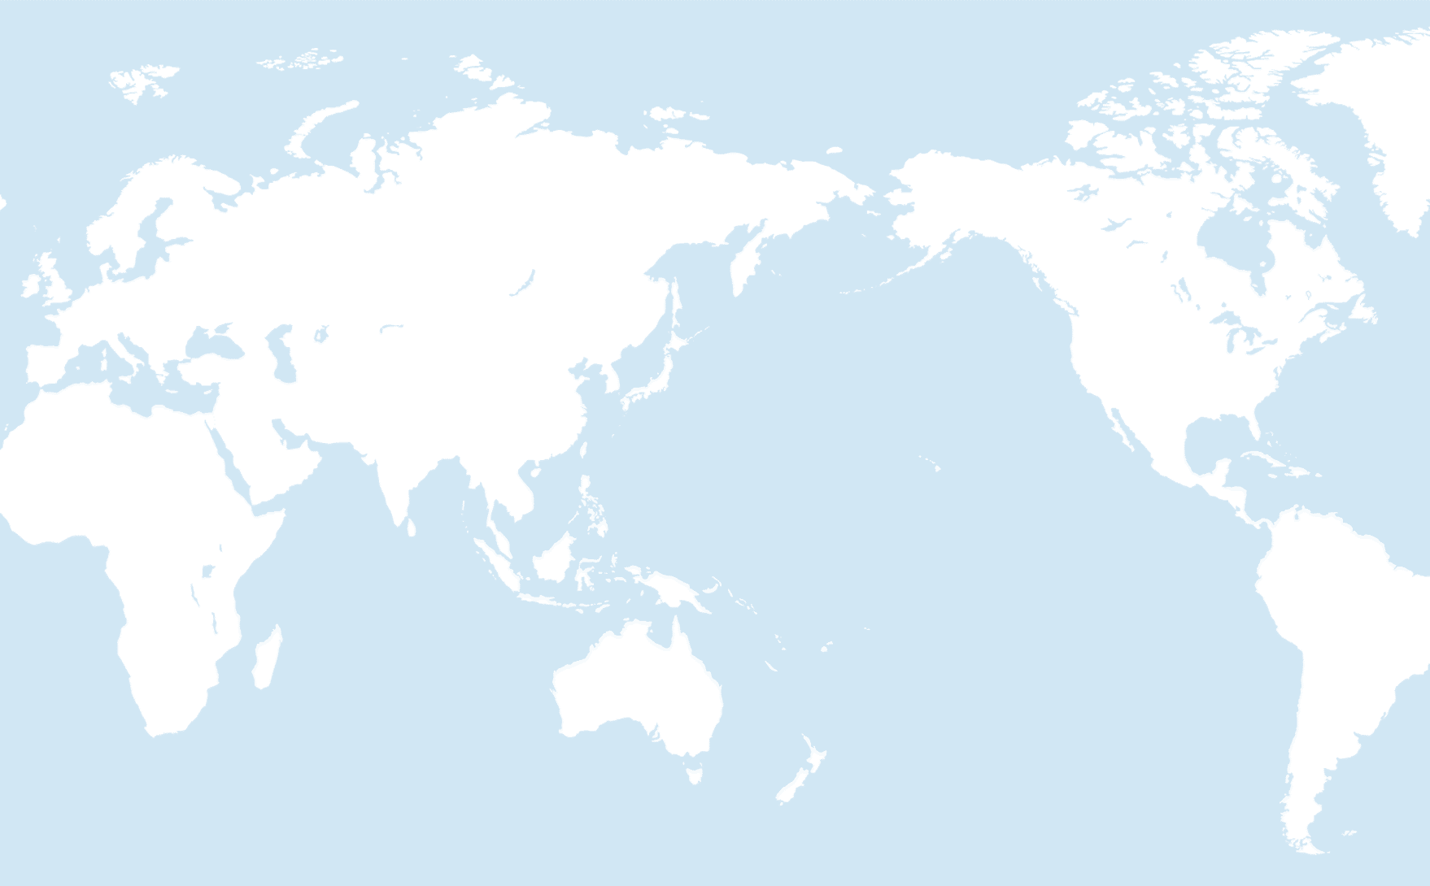
Ⅰ. Introduction of MITSUI-SOKO Group
4. Group Network：Overseas
Europe and Middle East
Czech, Denmark, Poland, Belgium, UK, Turkey, Hungary and UAE
MSC：29
MSE：4
MITSUI-SOKO （MSC）
MITSUI-SOKO EXPRESS（MSE）
MITSUI-SOKO SUPPLY CHAIN SOLUTIONS（MSCS）
MITSUI-SOKO TRANSPORT（MST）
China and Hong Kong
MSC：31
MSE：9
MST：9
Americas
USA, Canada, Mexico and Brazil
MSC：7
MSE：11
Kolding
EMA
CPH
SZZ
PRG
North East Asia
S.Korea and Taiwan
MSC：8
BRU
Esztergom
PEK
CGQ
SEA
DTW
YYZ
IST
TSN
DLC
ICN
CHI
CVG
XIY
TAO
PUS
LAX
EVV
SAV
CTU
WUH
SHA
SAN
ELP
SAT
DXB
CAN
TPE/TXG/KHH
GDL
Africa
South Africa
MSE：1
BLR
BKK
HKG/SZC
MEX
HPH
PEN
SGN
KUL
SIN
JHB
CGK
SUB
East South Asia
Singapore, Thailand, Malaysia, Indonesia, Vietnam and India
MSC：51
MSE：4
MSCS：2
SAO
DUR
Country | 23
Office & W/H | More than 170
Jurisdiction area | 700,000 ㎡
【CONFIDENTIAL】本資料は三井倉庫グループの許可なく対外的に参照・配布しないようお願い申し上げます。

Slide 9
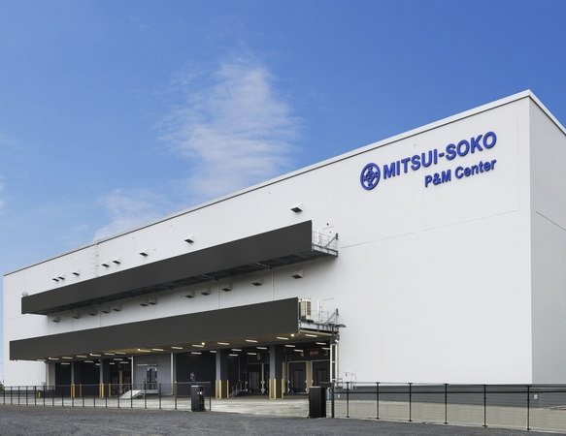
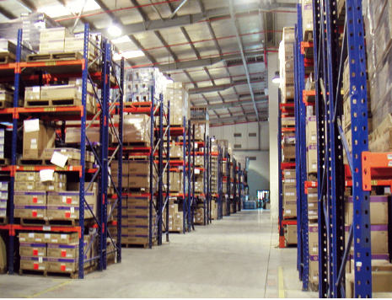
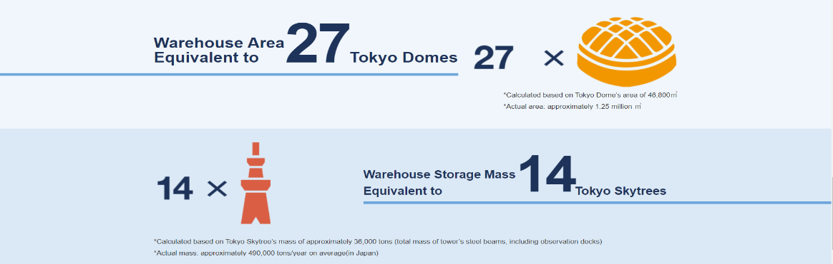
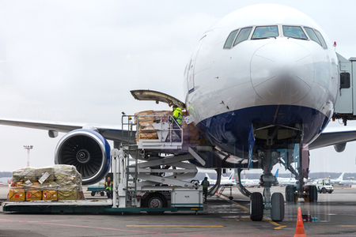
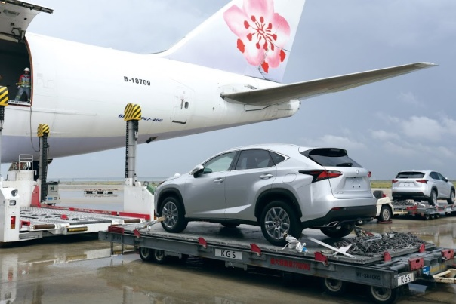
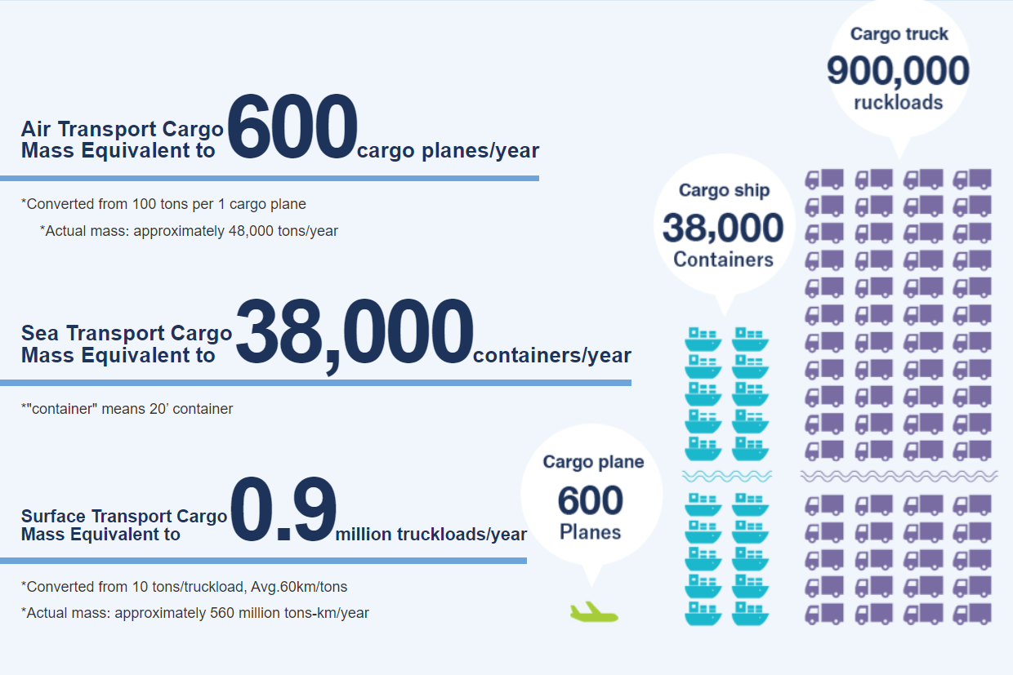
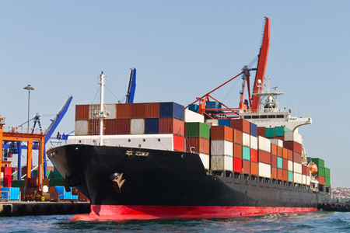
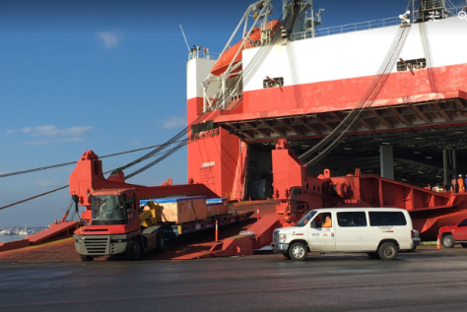
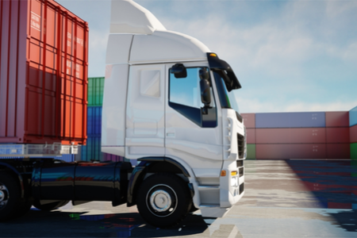
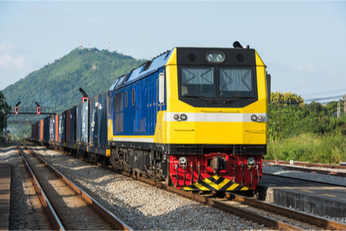
Ⅰ. Introduction of MITSUI-SOKO Group
5. Records
Warehouse
Transportation
【CONFIDENTIAL】本資料は三井倉庫グループの許可なく対外的に参照・配布しないようお願い申し上げます。

Slide 10
Ⅱ. Introduction of MITSUI-SOKO EXPRESS
【CONFIDENTIAL】本資料は三井倉庫グループの許可なく対外的に参照・配布しないようお願い申し上げます。

Slide 11
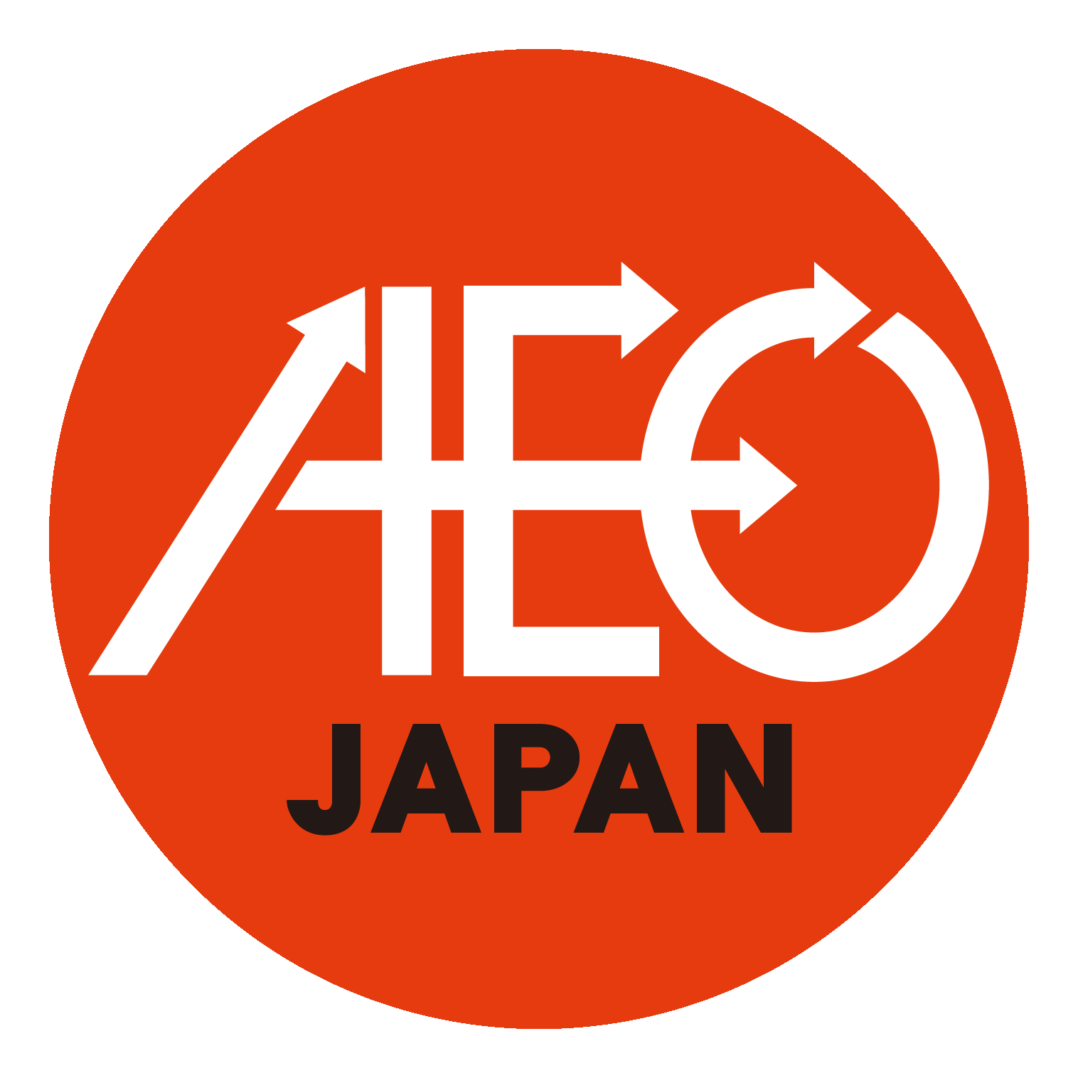
Ⅱ. Introduction of MITSUI-SOKO EXPRESS
1. Company Profile
◆Company profile
Company Name | MITSUI-SOKO EXPRESS Co., Ltd.
Headquarters | 3-20-1 Nishi-Shimbashi, Minato-ku, Tokyo, 105-0003, Japan
Representative | Hisanari Ichiryu, President and CEO
Capital stock | 400 million JPY
Share holders | MITSUI-SOKO HOLDINGS Co., Ltd. 64.2% Toyota Motor Corporation 35.8％
Employees | 438 (as of March, 2021)
Established | October 3, 1969
Main business areas | 1. IATA authorized cargo Agent 2. First class consigned Freight Forwarding Business (automobiles, transport and overseas shipping) 3. Second class consigned freight forwarding business (international air transport, overseas and coastal shipping) 4. Specified consigned freight forwarding business 5. Customs clearing agent (Tokyo, Osaka, Nagoya Customs) 6. Non-life insurance agent 7. Any business related to all of the above
Domestic offices | Kanto (Tokyo & Narita), Chubu (Nagoya, Toyoda, Takaoka & Centrair), Osaka (Dojima & KIX) and Kyushu (Fukuoka)
Overseas offices | USA, Canada, Mexico, Brazil, Belgium, UK, Czech, Turkey, South Africa, Thailand, Indonesia, India and China)
【CONFIDENTIAL】本資料は三井倉庫グループの許可なく対外的に参照・配布しないようお願い申し上げます。

Slide 12

Ⅱ. Introduction of MITSUI-SOKO EXPRESS
2. DNA
MITSUI-SOKO AIRCARGO has merged TAS Express, a subsidiary of TOYOTA as of July 1, 2012.
MITSUI-SOKO HD
TOYOTA
MITSUI-SOKO AIRCARGO
Air Transport
Ocean Transport
Customs Clearance
Overseas Moving
～Others
  Bulky Cargo
  Hazardous
  Temperature controlled
64.2％
35.8％
TAS Express
Air Transport
Ocean Transport
Customs Clearance
～ Especially
  Car
  Auto Parts
  Machinery
Integrating DNA of MITSUI-SOKO and
TOYOTA Motor, we provide a high quality international logistics service.
MITSUI
SOKO
＋
JTB
AIR CARGO
Merged 1st, March, 2011
【CONFIDENTIAL】本資料は三井倉庫グループの許可なく対外的に参照・配布しないようお願い申し上げます。

Slide 13

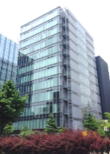

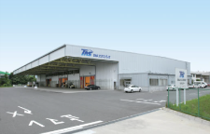
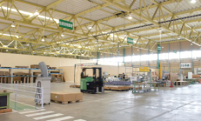
Ⅱ. Introduction of MITSUI-SOKO EXPRESS
3. Network: Domestic
Nagoya
Tokyo (HQ)
Osaka
Nagoya
Osaka
Tokyo(HQ)
Kansai
Narita
Toyoda
Toyoda
Kyushu
Centrair
Centrair
【CONFIDENTIAL】本資料は三井倉庫グループの許可なく対外的に参照・配布しないようお願い申し上げます。

Slide 14









Ⅱ. Introduction of MITSUI-SOKO EXPRESS
3. Network: Overseas
1
8
7
6
10
3
4
5
11
9
2
MSE EUROPE S.A.
MS EXPRESSS SOUTH AFRICA
MSE FORWARDERS
INDIA
MSE EXPRESS (THAILAND)
PUNINAR MSE INDONESIA
1
2
3
4
5
: Overseas Subsidiary Head Office
: Subsidiaries' Branch
6
7
8
9
MSE DO BRASIL LOGISTICA
MSE EXPRESS MEXICO,S.A.DE C.V.
MSE CHINA (GUANGZHOU)
MSE CHINA (BEIJING)
MSE EXPRESS AMERICA
10
【CONFIDENTIAL】本資料は三井倉庫グループの許可なく対外的に参照・配布しないようお願い申し上げます。

Slide 15
Ⅲ. OUR SERVICE
【CONFIDENTIAL】本資料は三井倉庫グループの許可なく対外的に参照・配布しないようお願い申し上げます。

Slide 16
Ⅲ. Our service
1. Global logistics service for auto parts
Full supports for auto parts pick-up / delivery supply chain in world-wide
Development
schedule
Development
Ready to mass production
Mass
production
Sales
Product
planning
Supplier
selection
Manufacture
selection
Auto parts
evaluation
Vehicle
evaluation
Factory line
evaluation
Ready to production
On time delivery for
production schedule
MSE JOB SCOPE
Logistics
flow
Export side
Country Ａ
Supplier a
Country A
MSE warehouse
JAPAN
(Airport)
JAPAN
MSE warehouse
JAPAN
(Assemble Man.)
Supplier b
Supplier c
Export side
Country Ｂ
Supplier a
Country B
MSE warehouse
Country X
(Airport)
Country X
MSE warehouse
Country X
(Assemble Man.)
Supplier b
Supplier c
Production/Ship
Check/Pack/Ship
Check/Ship
Check/Assort/Ship
Receive
Competitive Advantages
Ａ. Traceability
Help to trace cargo status easily as per management unit.
Easy to change due date flexibly by unexpected event(s) during
development schedule.
Ｂ. Purchase order Management
i) Notice of late delivery on be half of customer
ii) Invoice creation including price accuracy validation
Ｃ. High quality logistics
i) Verification with piece counting for precise quantity
ii) Proper packaging proposal according to the parts
 | Item | Competitor | ＭＳＥ
Ａ | Traceability | per BL | per unit customer needed
Ｂ-ⅰ | Warning | Customer responsibility | Warn on be half of customer
Ｂ-ⅱ | I/V Creation | Customer responsibility | Create with price validation
Ｃ-ⅰ | Cargo check | Contents unknown | Guarantee quantity in inner package
Ｃ-ⅱ | Packing | for mass production parts | for individual parts
【CONFIDENTIAL】本資料は三井倉庫グループの許可なく対外的に参照・配布しないようお願い申し上げます。

Slide 17
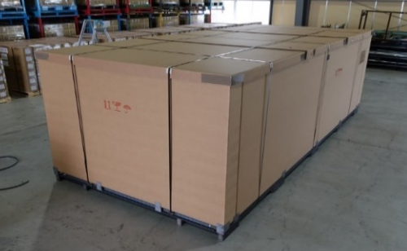
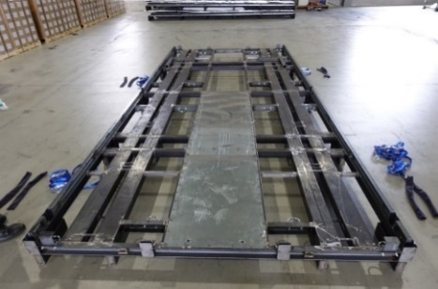
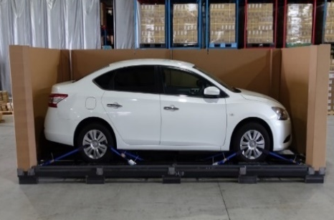
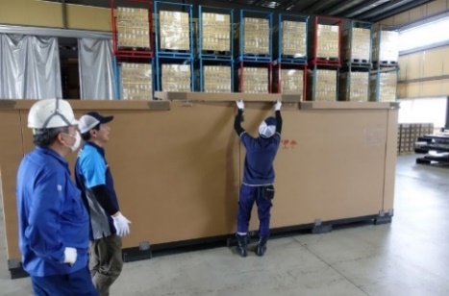
Ⅲ. Our service
2. Hybrid packaging for vehicle
Cost reduction and high-quality packing for vehicle shipping
(Registration of a design by Japan Patent Office)
■Hybrid packaging
Base: Steel
Sides: Reinforced cardboard
Top: Reinforced cardboard
■QCS Matrix
 |  | Steel box | Wooden box | Hybrid packaging
Quality | Strength | ◎ | ○ | ○
 | Water Proof | ◎ | △ | ○ (Water proof adhesive)
 | Recycle | ○ | ✕ | ○
Cost | Materials | △ | ○ (10～20% low) | ◎ (30～40% low)
 | Packing hours | △ 180min | △ 180min | ◎ 90min
Safety | Usability | △ Forklift, Wrench, Screwdriver and Claw bar | △ Forklift, Wrench, Screwdriver and Claw bar | ◎ Forklift and cutter only
【CONFIDENTIAL】本資料は三井倉庫グループの許可なく対外的に参照・配布しないようお願い申し上げます。

Slide 18
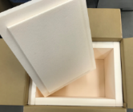
Ⅲ. Our service
3. Temperature controlled cargo
“e-Cool” provides high-quality packing and total shipping cost reduction for keep cool/frozen cargo
■e-Cool
Temp(℃)
【E-Cool performance test result】
ー Outside temp
ー Styrofoam
ー ”e-Cool”
e-Cool: more durable than Styrofoam
(almost double!)
0
Our own insulation
(h)
■Case study for total shipping cost reduction (NRT/PVG)
① Air freight: Keep Cool→General*
② Refrigerant: less quantity
③Additional work: No re-ice
-50%
-10%
-30%
Current
Current
Current
⇒ 40% reduction in total shipping cost by
*General cargo and without dry ice
【CONFIDENTIAL】本資料は三井倉庫グループの許可なく対外的に参照・配布しないようお願い申し上げます。

Slide 19
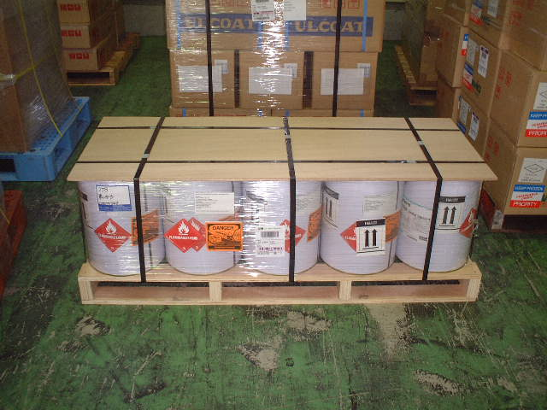
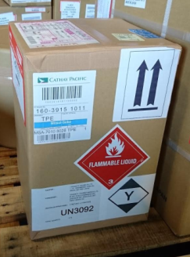

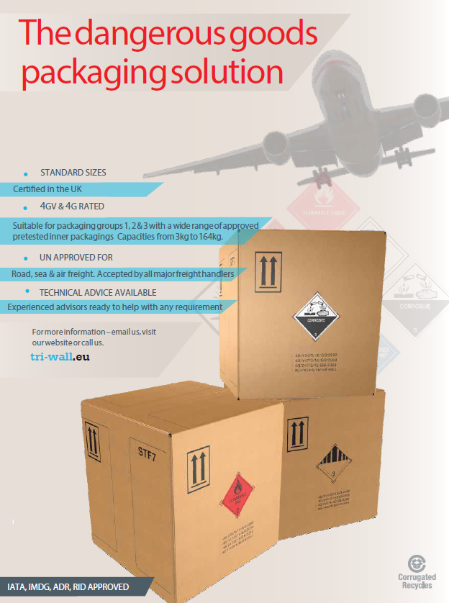
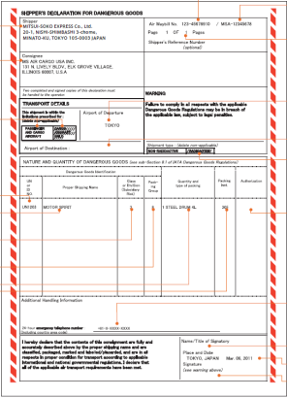
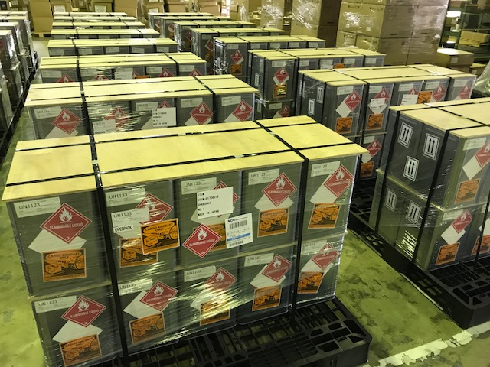
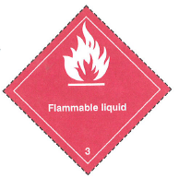

Ⅲ. Our service
4. Dangerous Goods
Consult proper packaging, labeling and documentation
Packing supports according to IATA DG
Regulation and item(s)
Marking/Labelling
UN Carton sales
Variety of packaging
Documentation, Marking &
Labeling
Wholesale of UN Cartons
【CONFIDENTIAL】本資料は三井倉庫グループの許可なく対外的に参照・配布しないようお願い申し上げます。

Slide 20

End of File
物流から価値を。

